Slide 1
Today
Lecture 6: Ginzburg-Landau theory --- supercurrents and fluxoid quantization
Discussion the Ginzburg-Landau theory in three parts:
Presentation of the model and derivation of the penetration length and coherence length
Calculation of the surface energy and categorization of Type I and Type II superconductivity
Current-carrying states and phase coherence
Next Tuesday
Lecture 7: BCS Theory

Slide 2
Physics 498 SQD --- previous topics for Superconductor Materials and Phenomena papers
Electronic Structure of a Superconducting Vortex Probed by Tunneling Microscopy
Acoustic Attenuation and Velocity Measurements in YBCO
Proximity Effects in Unconventional Superconductors
Brief Review of the Superconducting Properties of Niobium
A Survey of the Low Temperature Vortex State of the High-Tc Superconductor BSCCO
Superconductivity in A3C60
Detailed Phase Transition Structure in a High-Tc Superconductor
The Hebel-Slichter Coherence Peak in Fullerene Superconductors
The Proximity Effect in Al-Superconductor Systems Observed by Tunneling Spectroscopy
Muon Spin Relaxation Experiments as Evidence for Time-Reversal Symmetry Breaking in UPt3
Superconducting Properties of B36C60
Vortex Nucleation at Surfaces of Superconductors: Nascent Vortices
The Fullerene Controversy: Isotope Effect Discrepancies in Rb3C60
Phonon-Induced Enhancemnet of the Eneregy Gap of Superconducting Al Films
Superconducting Properties of BEDT-TIF
Some Superconducting Properties of Fullerenes
Review of some Physical Properties and Parameters of Nb3Sn and V3Sn
Flux Pinning in Chevrel Phase Superconductors
Ultrasound Attenuation in UPt3
Find something in superconductivity (a material, phenomenon, mystery, calculation, experiment, …) from the course or internet that interests you and explore and understand it
Paper ~ 10 pages w/ figures
“Due” Wednesday, October 30

Slide 3
Course content:
Lecture | Date |  | Day | Topic
Superconductor materials and phenomena
0 | Aug | 27 | Tues | NO CLASS --- qualifying exam
1 | Aug | 29 | Thurs | History and occurrence of superconductivity
2 | Sep | 3 | Tues | Defining phenomena: zero resistance, diamagnetism, energy gap, …
 | Sep | 5 | Thurs | NO CLASS --- cancelled
3 | Sep | 10 | Tues | Phenomenological theories: two-fluid, London, thermodynamic, ...
4 | Sep | 12 | Thurs | Ginzburg-Landau theory 1
5 | Sep | 17 | Tues | Ginzburg-Landau theory 2
6 | Sep | 19 | Thurs | Ginzburg-Landau theory 3
7 | Sep | 24 | Tues | BCS theory 1
8 | Sep | 26 | Thurs | BCS theory 2
9 | Oct | 1 | Tues | BCS theory 3
10 | Oct | 3 | Thurs | BCS theory 4
11 | Oct | 8 | Tues | Beyond BCS --- unconventional superconductivity, …
Quasiparticle and Josephson tunneling
12 | Oct | 10 | Thurs | Quasiparticle tunneling - theory
13 | Oct | 15 | Tues | Quasiparticle tunneling - applications
14 | Oct | 17 | Thurs | Josephson tunneling - theory
15 | Oct | 22 | Tues | Josephson tunneling – dc/ac effects
16 | Oct | 24 | Thurs | Josephson tunneling – magnetic field effects and Josephson interferometry
17 | Oct | 29 | Tues | Josephson tunneling – the RSJ model
 | Oct | 30 | Wed | Superconducting phenomenon/material paper due
18 | Oct | 31 | Thurs | Josephson tunneling - Microbridges/SNS Junctions/SFS junctions
19 | Nov | 5 | Tues | dc SQUIDS - model
20 | Nov | 7 | Thurs | dc SQUIDS - operation and applications
Superconductor devices for Quantum Information
21 | Nov | 12 | Tues | Quantum computing --- advantages and algorithms
22 | Nov | 14 | Thurs | Macroscopic quantum tunneling and coherence
23 | Nov | 19 | Tues | Conventional superconducting qubits
24 | Nov | 21 | Thurs | Superconducting qubit technology
 | Nov | 26 | Tues | Thanksgiving Break
 | Nov | 28 | Thurs | Thanksgiving Break
25 | Dec | 3 | Tues | Topological materials and Majorana fermions
26 | Dec | 5 | Thurs | Majorana qubits --- nanowires
27 | Dec | 10 | Tues | Majorana qubits --- S-TI-S junctiosn
 | Dec | 12 | Thurs | READING DAY
 | Dec | 18 | Wed | "FINAL EXAM" --- Superconductor device paper due
Superconductor materials and phenomena
Lecture | Date |  | Day | Topic
Superconductor materials and phenomena
0 | Aug | 27 | Tues | NO CLASS --- qualifying exam
1 | Aug | 29 | Thurs | History and occurrence of superconductivity
2 | Sep | 3 | Tues | Defining phenomena: zero resistance, diamagnetism, energy gap, …
 | Sep | 5 | Thurs | NO CLASS --- cancelled
3 | Sep | 10 | Tues | Phenomenological theories: two-fluid, London, thermodynamic, ...
4 | Sep | 12 | Thurs | Ginzburg-Landau theory 1
5 | Sep | 17 | Tues | Ginzburg-Landau theory 2
6 | Sep | 19 | Thurs | Ginzburg-Landau theory 3
7 | Sep | 24 | Tues | BCS theory 1
8 | Sep | 26 | Thurs | BCS theory 2
9 | Oct | 1 | Tues | BCS theory 3
10 | Oct | 3 | Thurs | BCS theory 4
11 | Oct | 8 | Tues | Beyond BCS --- unconventional superconductivity, …
Quasiparticle and Josephson tunneling
12 | Oct | 10 | Thurs | Quasiparticle tunneling - theory
13 | Oct | 15 | Tues | Quasiparticle tunneling - applications
14 | Oct | 17 | Thurs | Josephson tunneling - theory
15 | Oct | 22 | Tues | Josephson tunneling – dc/ac effects
16 | Oct | 24 | Thurs | Josephson tunneling – magnetic field effects and Josephson interferometry
17 | Oct | 29 | Tues | Josephson tunneling – the RSJ model
 | Oct | 30 | Wed | Superconducting phenomenon/material paper due
18 | Oct | 31 | Thurs | Josephson tunneling - Microbridges/SNS Junctions/SFS junctions
19 | Nov | 5 | Tues | dc SQUIDS - model
20 | Nov | 7 | Thurs | dc SQUIDS - operation and applications
Superconductor devices for Quantum Information
21 | Nov | 12 | Tues | Quantum computing --- advantages and algorithms
22 | Nov | 14 | Thurs | Macroscopic quantum tunneling and coherence
23 | Nov | 19 | Tues | Conventional superconducting qubits
24 | Nov | 21 | Thurs | Superconducting qubit technology
 | Nov | 26 | Tues | Thanksgiving Break
 | Nov | 28 | Thurs | Thanksgiving Break
25 | Dec | 3 | Tues | Topological materials and Majorana fermions
26 | Dec | 5 | Thurs | Majorana qubits --- nanowires
27 | Dec | 10 | Tues | Majorana qubits --- S-TI-S junctiosn
 | Dec | 12 | Thurs | READING DAY
 | Dec | 18 | Wed | "FINAL EXAM" --- Superconductor device paper due
Superconductor device physics
Paper #1
Applications in quantum information
Paper #2

Slide 4



















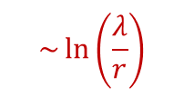
Type II Superconductivity
$H>"H_{c}"⟹$ field penetrates in discrete vortices
VORTEX STATE
(1) $κ=\frac{λ}{ξ} > \frac{1}{\sqrt{2}} ⟹$ negative surface energy $⟹$ maximize N-S interface area
(2) Fluxoid quantization $⟹$ smallest flux unit $=Φ_{o}$
$$\sim \ln\left(\frac{λ}{r}\right)$$
B
$$\left|ψ\right|$$
$$\sim e^{{±r}/ξ}$$
MEISSNER
$$B=0$$
VORTEX
NORMAL
$$B=H$$
$$−4πM$$
B
I I I I
r
H
$$λ$$
$$ξ$$
$$ξ$$
$$λ$$
$$H_{c1}$$
$$H_{c2}$$
$$H_{c_{3}}$$
NORMAL
SURFACE
nucleation of SC at surface
$$n=\frac{B}{Φ_{o}}$$
$$H_{c_{2}}$$
Vortex density:
nucleation of SC in bulk
$$H_{c_{1}}$$
VORTEX
flux entry into SC
MEISSNER
$$T$$
$$T_{c}$$

Slide 5
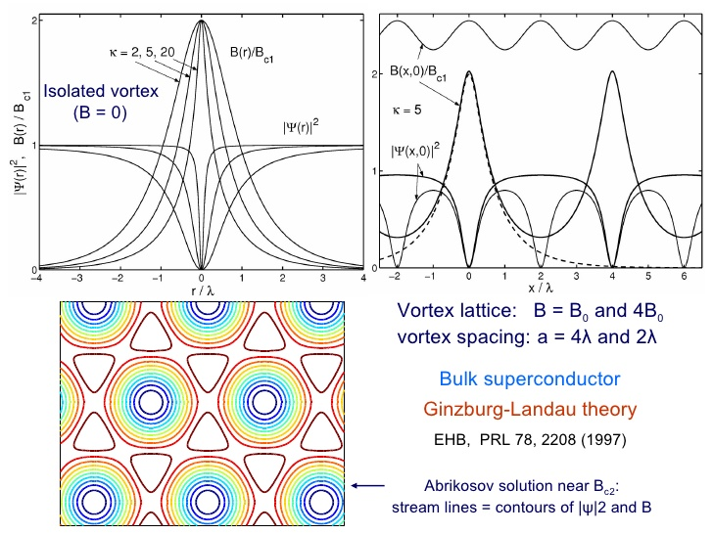

Slide 6

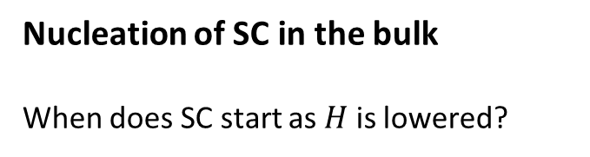


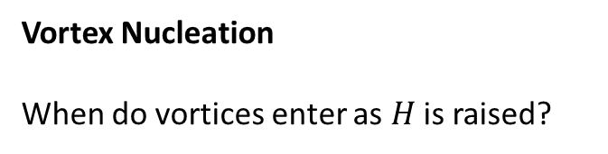
When do these states form?
Nucleation of SC in the bulk
When does SC start as $H$ is lowered?
$$H_{c2}$$
“upper critical field”
$$H_{c2}=\frac{Φ_{0}}{2_{π}ξ^{2}}=\frac{4_{π}λ^{2}H_{c}^{2}}{Φ_{0}}=\sqrt{2 }κ H_{c}$$
“upper critical field”
Vortex Nucleation
When do vortices enter as $H$ is raised?
$$H_{c1}$$
“lower critical field”

Slide 7





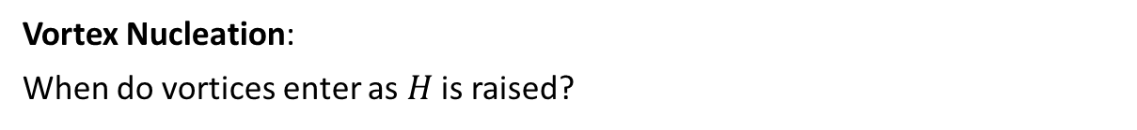



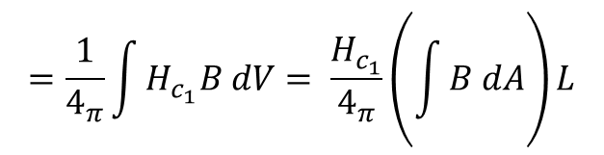

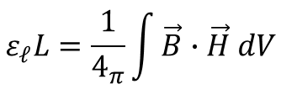
Vortex Nucleation:
When do vortices enter as $H$ is raised?
Define critical field $H_{c_{1}}$
At $H_{c_{1}}$ $G_{S}^{Meissner}={ G}_{s}^{vortex}$
$$L$$
0 vortices
1 vortex
$$B$$
$$H$$
$$H_{c_{1}}$$
$$H_{c_{2}}$$
Let $ε_{ℓ}=$ line energy of vortex/length
Tradeoff vortex energy vs. field energy (to allow $B$ to penetrate when applied field is $H_{c_{1}}$)
$$=\frac{1}{4_{π}}\int{H_{c_{1}}B dV= \frac{H_{c_{1}}}{4_{π}}\left(\int{B dA}\right)L}$$
$$ε_{ℓ}L=\frac{1}{4_{π}}\int{\vec{B}∙\vec{H} dV}$$
$$=\frac{H_{c_{1}}}{4_{π}}{ Φ}_{0} L$$
$$∴H_{c_{1}}=\frac{4_{π}ε_{ℓ}}{Φ_{0}}$$
“lower critical field”

Slide 8
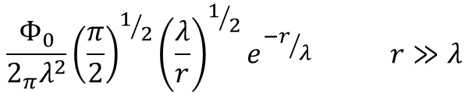

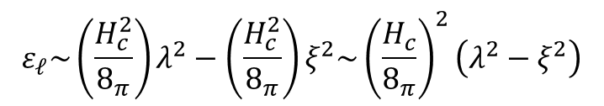
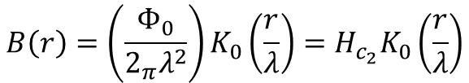

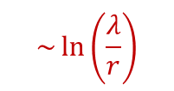






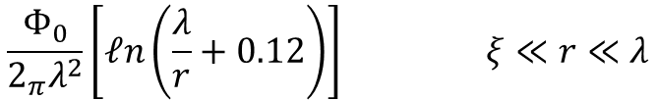

$εℓ$? Must solve $GL$ to get vortex slope: $ψ\left(r\right), A\left(r\right)$
Calculate line energy (field energy +$KE$
$$ε_{ℓ}\sim \left(\frac{H_{c}^{2}}{8_{π}}\right)λ^{2}−\left(\frac{H_{c}^{2}}{8_{π}}\right)ξ^{2}\sim {\left(\frac{H_{c}}{8_{π}}\right)}^{2}\left(λ^{2}−ξ^{2}\right)$$
Guess:
$$\sim \ln\left(\frac{λ}{r}\right)$$
field
energy
condensation
energy
B
$$\left|ψ\right|$$
$$\sim e^{{±r}/ξ}$$
Solutions $\left(κ≫\frac{1}{\sqrt{2}}\right)$ use full $GL$
I I I I
r
$$ψ\left(r\right)\sim \left|ψ_{∞}\right| tanh \frac{r}{ξ}$$
$$λ$$
$$ξ$$
$$ξ$$
$$λ$$
$$\frac{Φ_{0}}{2_{π}λ^{2}}{\left(\frac{π}{2}\right)}^{1/2}{\left(\frac{λ}{r}\right)}^{1/2}e^{{−r}/λ} r≫λ$$
(long range)
$$B\left(r\right)=\left(\frac{Φ_{0}}{2_{π}λ^{2}}\right)K_{0}\left(\frac{r}{λ}\right)=H_{c_{2}}K_{0}\left(\frac{r}{λ}\right)$$
$$=$$
$$\frac{Φ_{0}}{2_{π}λ^{2}}\left[ℓn\left(\frac{λ}{r}+0.12\right)\right] ξ≪r≪λ$$
(short range)
zero – order Hankel function
$B\left(r\right)$ does not diverge in core – flattens off as ${\left|ψ\right|}^{2}→0$ near center

Slide 9





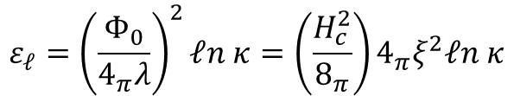



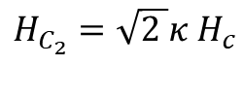

$$ε_{ℓ}={\left(\frac{Φ_{0}}{4_{π}λ}\right)}^{2}ℓn κ=\left(\frac{H_{c}^{2}}{8_{π}}\right)4_{π}ξ^{2}ℓn κ$$
Find for the line energy:
$$H_{c_{1}}=\frac{4_{π}}{Φ_{0}}ε_{1}=\frac{Φ_{0}}{4_{π}λ^{2}}ℓn κ=H_{c}\frac{ℓn κ }{\sqrt{2 }κ }$$
$$H_{c_{1}}=H_{c}\frac{ℓn κ }{\sqrt{2 }κ }$$
$$H_{c}=\frac{1}{\sqrt{ℓn κ }}{\left(H_{c_{1}}H_{c_{2}}\right)}^{1/2}$$
$$H_{C_{2}}=\sqrt{2 }κ{ H}_{c}$$
$$H_{c_{1}}\sim \frac{Φ_{0}}{λ^{2}}$$
areas equal
$$−4πM$$
$$H_{c_{2}}\sim \frac{Φ_{0}}{ξ^{2}}$$
$$H_{c_{1}}$$
$$H_{c}$$
$$H_{c_{2}}$$

Slide 10






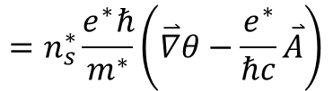


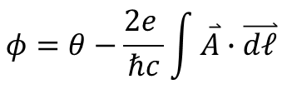
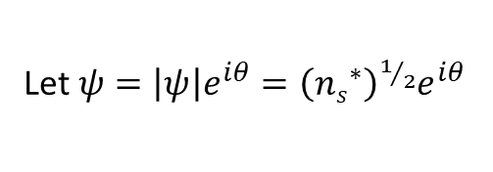

Current-Carrying Situations
$GL2:$ cannot neglect phase ---
$ψ$is complex
$${\overline{J}}_{s}=\frac{e^{∗}ℏ}{{2m}^{∗}i}\left(ψ^{∗}\overset{⃑}{∇}ψ−ψ\overset{⃑}{∇}ψ^{∗}\right)−\frac{{\left(e^{∗}\right)}^{2}}{m^{∗}c}ψ^{∗}ψ\overset{⃑}{A}$$
Let $ψ=\left|ψ\right|e^{iθ}={\left({ns}^{∗}\right)}^{1/2}e^{iθ}$
$${\overset{⃑}{J}}_{s}=\frac{e^{∗}ℏ}{m^{∗}}n_{s}^{∗}\overset{⃑}{∇}θ−\frac{{\left(e^{∗}\right)}^{2}}{m^{∗}c}n_{s}^{∗}\overset{⃑}{A}$$
$$=n_{s}^{∗}\frac{e^{∗}ℏ}{m^{∗}}\left(\overset{⃑}{∇}θ−\frac{e^{∗}}{ℏc}\overset{⃑}{A}\right)$$
alternate descriptions
$${\overset{⃑}{J}}_{s}=n_{s}^{∗}\frac{e^{∗}ℏ}{m^{∗}}\overset{⃑}{∇}φ$$
$${\overset{⃑}{j}}_{s}=n_{s}^{∗}e^{∗}{\overset{⃑}{v}}_{s}$$
$$=n_{s}\frac{eℏ}{2m}\overset{⃑}{∇}φ$$
$$=n_{s}e{\overset{⃑}{v}}_{s}$$
$$φ=θ−\frac{{2e}^{ }}{ℏc}\int{\overset{⃑}{A}∙\overset{⃑}{dℓ}}$$
$$\overset{⃑}{p}=\frac{ℏ}{2m}\overset{⃑}{∇}θ=m^{∗}{\overset{⃑}{v}}_{s}+\frac{e^{∗}}{c}\overset{⃑}{A}$$
“gauge-invariant phase”
“canonical momentum”

Slide 11

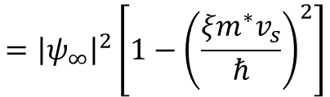







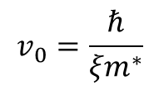




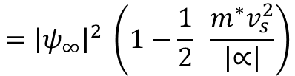


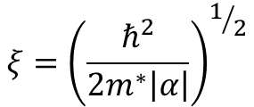




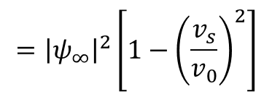

Critical Current wire or film $\left(d≪ξ,λ\right)$
$$\overset{⃑}{J}$$
$\left|ψ\right|$ uniform but may be suppressed $<\left|ψ_{∞}\right|$
$$\overset{⃑}{∇}\left|ψ\right|=0$$
$H=B$ (non-screening)
$${\overset{⃑}{J}}_{s}={\left|ψ\right|}^{2}eυ_{s}^{∗}≤n_{s}^{∗}e^{∗}v_{s}^{∗}$$
$$ΔG=α{\left|ψ\right|}^{2}+\frac{1}{2}β{\left|ψ\right|}^{4}+\frac{ℏ^{2}}{{2m}^{∗}}{\left(\overset{⃑}{∇}\left|ψ\right|\right)}^{2}+\left(\frac{1}{2}m^{∗}v_{s}^{2}\right){\left|ψ\right|}^{2}+\frac{1}{8π}{\left(H−B\right)}^{2}$$
$$=α{\left|ψ\right|}^{2}+\frac{1}{2}β{\left|ψ\right|}^{4}+\frac{1}{2}m^{∗}v_{s}^{2}{\left|ψ\right|}^{2}$$
Minimize $∆G$wrt
$${\left|ψ\right|}^{2}⇒$$
$$α+β{\left|ψ\right|}^{2}+\frac{1}{2}m^{∗}v_{s}^{2}=0$$
$${\left|ψ_{∞}\right|}^{2}$$
$${\left|ψ\right|}^{2}=\frac{α}{β}−\frac{1}{2}\frac{m^{∗}v_{s}^{2}}{β}$$
$$ψ^{2}$$
$$={\left|ψ_{∞}\right|}^{2} \left(1−\frac{1}{2} \frac{m^{∗}v_{s}^{2}}{\left|∝\right|}\right)$$
$${\left|ψ_{∞}\right|}^{2}=−\frac{α}{β}$$
$$v_{s}$$
$$v_{c}$$
$$v_{0}$$
$$={\left|ψ_{∞}\right|}^{2}\left[1−{\left(\frac{{ξm}^{∗}v_{s}}{ℏ}\right)}^{2}\right]$$
$$ξ={\left(\frac{ℏ^{2}}{{2m}^{∗}\left|α\right|}\right)}^{1/2}$$
${\left|ψ\right|}^{2}→0$ at $v_{0}=\frac{ℏ}{{ξm}^{∗}}$
$$={\left|ψ_{∞}\right|}^{2}\left[{1−\left(\frac{v_{s}}{v_{0}}\right)}^{2}\right]$$
$$v_{0}=\frac{ℏ}{{ξm}^{∗}}$$
Like a deBroglie
wavelength
$$ξ=\frac{ℏ}{m^{∗}v_{0}}$$

Slide 12





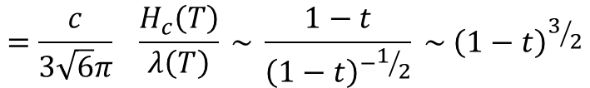


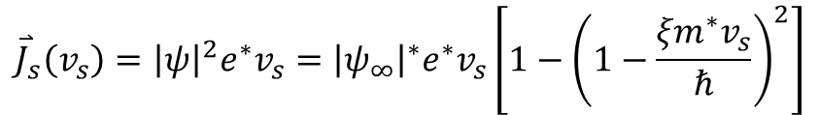

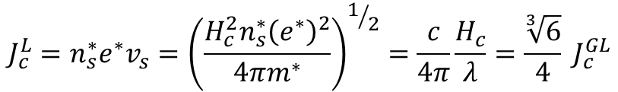








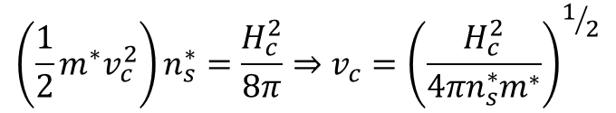


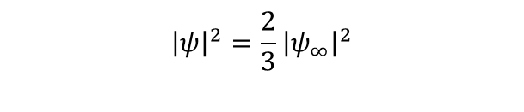

At $v_{c}$ (max
$J_{s}$)
$${\overset{⃑}{J}}_{s}\left(v_{s}\right)={\left|ψ\right|}^{2}e^{∗}v_{s}={\left|ψ_{∞}\right|}^{∗}e^{∗}v_{s}\left[1−{\left(1−\frac{{ξm}^{∗}v_{s}}{ℏ}\right)}^{2}\right]$$
$${\left|ψ_{∞}\right|}^{2}$$
$${\left|ψ\right|}^{2}=\frac{2}{3}{\left|ψ_{∞}\right|}^{2}$$
$$ψ^{2}$$
$$J_{c}$$
$J_{s}$ max at $v_{c}=\frac{1}{\sqrt{3}}\frac{ℏ}{{ξm}^{∗}}$
$$=\frac{1}{\sqrt{3}}v_{0}$$
$$v_{s}$$
$$v_{c}$$
$$v_{0}$$
$$J_{s}$$
$$v_{c}$$
$$\sim 0.6v_{0}$$
Increase current, wire goes normal at
$${\left|ψ\right|}^{2}$$
$$J_{c}$$
$$v_{s}$$
$$v_{c}$$
$$v_{0}$$
$$J$$
$$J_{c}=\frac{2}{3\sqrt{3}} \frac{e^{∗}ℏ}{m^{∗ξ}}{ \left|ψ_{∞}\right|}^{2}$$
“GL depairing current”
$$J_{c}$$
Compare to London model: $\left|ψ\right|=\left|ψ_{∞}\right|$ always
$$=\frac{c}{3\sqrt{6}π} \frac{H_{c}\left(T\right)}{λ\left(T\right)} \sim \frac{1−t}{{\left(1−t\right)}^{−1/2}} \sim {\left(1−t\right)}^{3/2}$$
$$\left(\frac{1}{2}m^{∗}v_{c}^{2}\right)n_{s}^{∗}=\frac{H_{c}^{2}}{8π}⇒v_{c}={\left(\frac{H_{c}^{2}}{{4πn}_{s}^{∗}m^{∗}}\right)}^{1/2}$$
This is observed in experiments if piling up of currents can be avoided by using small wires or ground-planed thin films
$$J_{c}^{L}=n_{s}^{∗}e^{∗}v_{s}={\left(\frac{H_{c}^{2}n_{s}^{∗}{\left(e^{∗}\right)}^{2}}{{4πm}^{∗}}\right)}^{1/2}=\frac{c}{4π}\frac{H_{c}}{λ}=\frac{\sqrt[3]{6}}{4} J_{c}^{GL}$$
Larger (x 1.84) -- neglects suppression of $\left|ψ\right|$ by the current

Slide 13

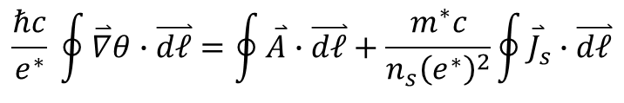





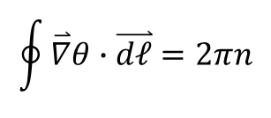
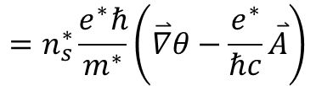


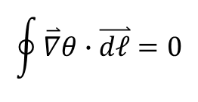
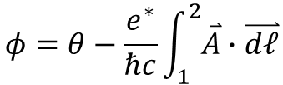
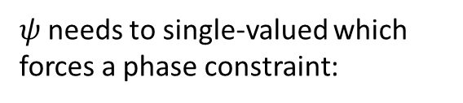


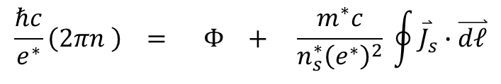
Flux Quantization
$$ψ$$
$GL→$ microscopic coherence r $ξ$
(range of changes in )
$ψ$needs to single-valued which forces a phase constraint:
microscopic phase coherence over long range $\left(∞ ?\right)$
Singly-connected
Multiply-connected
$${\overset{⃑}{J}}_{s}=\frac{e^{∗}ℏ}{{2m}^{∗}i}\left(ψ^{∗}\overset{⃑}{∇}ψ−ψ\overset{⃑}{∇}ψ^{∗}\right)−\frac{{\left(e^{∗}\right)}^{2}}{m^{∗}c}\left(ψ^{∗}ψ\right)\overset{⃑}{A}$$
$$ψ={\left(n_{s}^{∗}\right)}^{\frac{1}{2}}{ e}^{iθ}$$
$${\overset{⃑}{J}}_{s}=\frac{e^{∗}ℏ}{m^{∗}}n_{s}^{∗}\overset{⃑}{∇}θ−\frac{{\left(e^{∗}\right)}^{2}}{m^{∗}c}n_{s}^{∗}\overset{⃑}{A}$$
$$\oint{\overset{⃑}{∇}θ}∙\overset{⃑}{dℓ}=0$$
$$\oint{\overset{⃑}{∇}θ}∙\overset{⃑}{dℓ}=2πn$$
$$=n_{s}^{∗}\frac{e^{∗}ℏ}{m^{∗}}\left(\overset{⃑}{∇}θ−\frac{e^{∗}}{ℏc}\overset{⃑}{A}\right)$$
$$\frac{ℏc}{e^{∗}}\overset{⃑}{∇}θ=\overset{⃑}{A} + \frac{m^{∗}c}{n_{s}{\left(e^{∗}\right)}^{2}}{ \overset{⃑}{J}}_{s}$$
$$2$$
$$\frac{ℏc}{e^{∗}} \oint{\overset{⃑}{∇}θ∙\overset{⃑}{dℓ}=\oint{\overset{⃑}{A}}∙\overset{⃑}{dℓ}}+\frac{m^{∗}c}{n_{s}{\left(e^{∗}\right)}^{2}}\oint{{\overset{⃑}{J}}_{s}∙\overset{⃑}{dℓ}}$$
$$\overset{⃑}{∇}φ$$
$$φ=θ−\frac{e^{∗}}{ℏc}\int_{1}^{2}{\overset{⃑}{A}∙\overset{⃑}{dℓ}}$$
$$1$$
$$\frac{ℏc}{e^{∗}}\left(2πn \right) = Φ + \frac{m^{∗}c}{n_{s}^{∗}{\left(e^{∗}\right)}^{2}} \oint{{\overset{⃑}{J}}_{s}∙\overset{⃑}{dℓ}}$$
$=$ gauge invariant phase
“fluxoid”
magnetic
flux
kinetic
flux

Slide 14

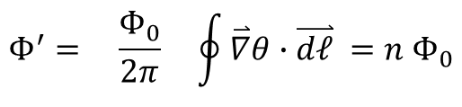






Fluxoid quantized in units of $Φ_{0}= \frac{hc}{2e}$ “flux quantum”
$$Φ_{0}=2.07×{10}^{−15 }Wb=2.07 ×{10}^{−7} G−cm^{2}$$
Fluxoid
$$Φ^{′}= \frac{Φ_{0}}{2π} \oint{\overset{⃑}{∇}θ∙\overset{⃑}{dℓ}} =n{ Φ}_{0}$$
Special case : Bulk$SC→ {\overset{⃑}{J}}_{s}=0$
$$H$$
$$Φ^{′}=Φ = nΦ_{0}$$
=
field-cooled superconductor cylinder
Deaver & Fairbank (1961)
$$Φ$$
$$e^{∗}=2e!$$
$$H_{ }$$

Slide 16




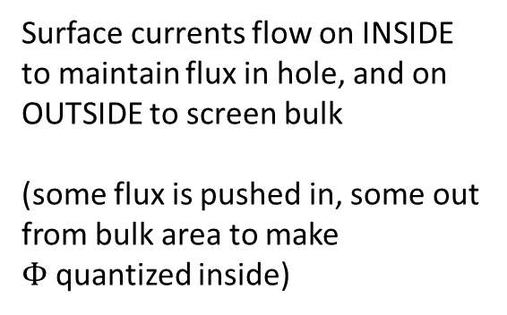



How can flux be quantized if ${\overset{⃑}{J}}_{s}=0?$
CURRENTS flow within $λ$ of surfaces
$$H_{ }$$
Zero-field cooled
Surface currents flow on OUTSIDE as field is applied –
screens bulk of SC and hole
$$Φ=0 \left(n=0\right)$$
Finite-field cooled
$H_{ }→0$
$$H_{ }$$
Surface currents flow on INSIDE to maintain flux in hole, and on OUTSIDE to screen bulk
(some flux is pushed in, some out from bulk area to make $Φ$quantized inside)
INSIDE currents persist
OUTSIDE currents reduce
$$⟹$$
TRAPPED FLUX
Magnet with no power supply!

Slide 17
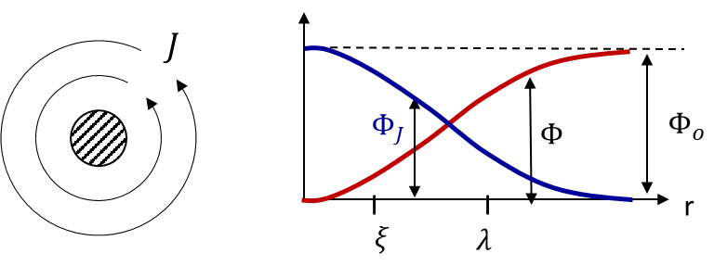



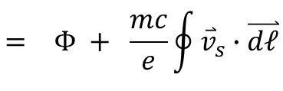



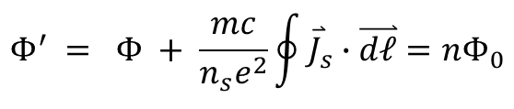








Fluxoid Quantization:
$$Φ^{′} = Φ + \frac{mc}{n_{s}e^{2}}\oint{{\overset{⃑}{J}}_{s}∙\overset{⃑}{dℓ}=nΦ_{0}}$$
$$= Φ + \frac{mc}{e}\oint{{\overset{⃑}{v}}_{s}}∙\overset{⃑}{dℓ}$$
${\overset{⃑}{J}}_{s} = 0 ⇒ Φ=nΦ_{0}$ flux quantization
${\overset{⃑}{J}}_{s} ≠ 0 ⇒ Φ^{′}=nΦ_{0}$ flux is not quantized
SITUATIONS where this applies
$$Φ^{′}=nΦ_{0}$$
(1) Near surfaces (within $λ$)
$SC s$ample with trapped flux
$$B,J$$
$$Φ$$
$$Φ$$
$$\frac{mc}{n_{s}e^{2}}\oint{{\overset{⃑}{J}}_{s}}\overset{⃑}{dℓ}$$
$$λ$$
(2) Near vortex core (within $λ)$
(3) Thin samples $\left(w<λ\right)⇒$ Little-Parks experiment
(4) Rotating sample $⇒$ London rotation
(5) Transport current ${\overset{⃑}{j}}_{n}⇒$ thermoelectric effect
(6) $SC$ weak links $⇒$Josephson effect
(7) Unconventional $SC⇒$ $d$-wave, $p$-wave symmetry

Slide 18
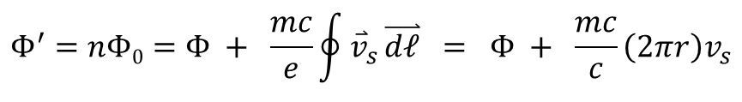










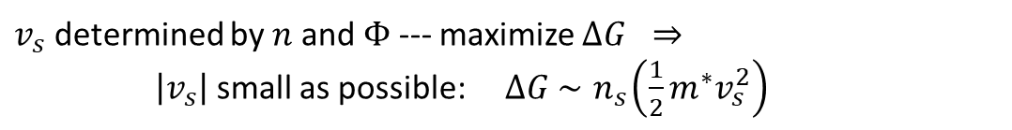
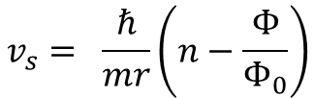

(3) Little-Parks Experiment (1962)
Data:
$$R$$
$$Φ$$
$R$is periodic in $Φ$
=
$$r$$
Measure resistance of a superconductor cylinder just above T_{c}
V
$$Φ/Φ_{0}$$
-3 -2 -1 0
1 2 3
$$n$$
2
1
Model:
0
-1
$$Φ/Φ_{0}$$
$$Φ^{′}=nΦ0=Φ + \frac{mc}{e}\oint{{\overset{⃑}{v}}_{s}}\overset{⃑}{dℓ} = Φ + \frac{mc}{c}\left({2πr}_{ }\right)v_{s}$$
1
2
$$v_{s}$$
$$v_{s}= \frac{ℏ}{mr}\left(n−\frac{Φ}{Φ_{0}}\right)$$
2
$$Φ/Φ_{0}$$
1
$v_{s}$ determined by $n$ and $Φ$ --- maximize $ΔG ⇒$
$\left|v_{s}\right|$ small as possible: $∆G \sim { n}_{s}\left(\frac{1}{2}m^{∗}v_{s}^{2}\right)$
$$v_{s}^{2}$$
1
2
$$Φ/Φ_{0}$$

Slide 19



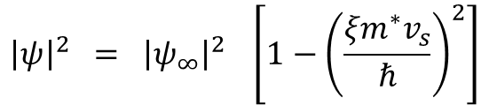







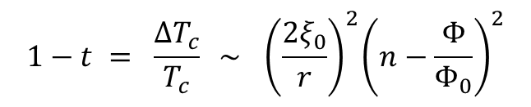
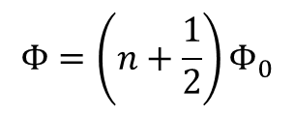
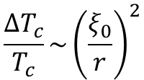
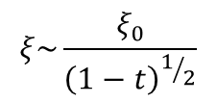





Recall variation of $\left|ψ\right|$ with $v_{s}$:
$${\left|ψ\right|}^{2} = {\left|ψ_{∞}\right|}^{2} \left[1−{\left(\frac{{ξm}^{∗}v_{s}}{ℏ}\right)}^{2}\right]$$
$${\left|ψ\right|}^{2}$$
$${\left|ψ_{∞}\right|}^{2}$$
$$={ \left|ψ_{∞}\right|}^{2} \left[1−{\left(\frac{2ξ}{r}\right)}^{2}{\left(n−\frac{Φ}{Φ0}\right)}^{2}\right]$$
$$\frac{Φ}{Φ_{0}}$$
$$−2 −1 0 1 2$$
$$∆T_{c}$$
ria
Transition temperature $T_{c}$ when ${\left|ψ\right|}^{2}→0 \left(d≪ξ,λ\right)$
$$\frac{1}{ξ^{2}} = {\left(\frac{2}{r}\right)}^{2}{\left(n−\frac{Φ}{Φ_{0}}\right)}^{2} \sim \frac{1−t}{ξ_{0}^{2}}$$
$$−2 −1 0 1 2$$
$$\frac{Φ}{Φ_{0}}$$
$$ξ\sim \frac{ξ_{0}}{{\left(1−t\right)}^{1/2}}$$
$$1−t = \frac{{∆T}_{c}}{T_{c}} \sim { \left(\frac{{2ξ}_{0}}{r}\right)}^{2}{\left(n−\frac{Φ}{Φ_{0}}\right)}^{2}$$
$$t=\frac{T }{Tc}$$
Shows up experimentally as a variation in $R$ (at constant $T):$
$$Φ=\frac{1}{2}Φ_{0}$$
Max suppression is
$$\frac{{ΔT}_{c}}{T_{c}}\sim {\left(\frac{ξ_{0}}{r}\right)}^{2}$$
$$Φ=\left(n+\frac{1}{2}\right)Φ_{0}$$
$$∆T_{c}$$
$$Φ=0$$
at
$$R$$
$$T$$
$$T_{c}^{ }$$

Slide 20





Significance of Little-Parks experiments:
showed reality of the “fluxoid”
(2) demonstrated use of $GL$ free energy to understand experiments
Sharvin & Sharvin repeated this experiment for nanoscale normal rings:
$$r$$
$$R$$
Observed quantized magnetoresistance oscillations for
$2πr < ℓ_{φ}=v_{F}τ_{φ}$
$$H$$
phase coherence length in $N (<1μm)$
This is due to phase coherence in normal metals over microscopic scales, not superconductivity
Important result in nanoscale physics

Slide 21





















(4) London rotation – spinning $SC$ ring (thin)
$$\oint{{\overset{⃑}{J}}_{s}∙\overset{⃑}{dℓ}≠0}$$
In rest frame,
$$0$$
$$Φ=nΦ_{0} − \frac{mc}{e}\oint{{\overset{⃑}{v}}_{s}∙\overset{⃑}{dℓ}}$$
Net magnetic flux generated due to rotation:
$$ω$$
$$= −\frac{mc}{e}\left(ωR\right)2πR$$
$$= −\frac{2mc}{e}\left({πR}^{2}\right)ω$$
$$= −\frac{2mc}{e}Aω$$
“London moment”
General Rotation:
$$A=$$
Area of loop
$${\overset{⃑}{v}}_{S}$$
$$\overset{⃑}{v}s=\overset{⃑}{ω}×\overset{⃑}{r}$$
$$\overset{⃑}{r}$$
$$Φ =−\frac{mc}{e}\oint{\overset{⃑}{v}s∙dℓ}=−\frac{mc}{e}\int_{A}^{ }{\left(\overset{⃑}{∇}×\overset{⃑}{v}s\right)∙\overset{⃑}{dA}}$$
$$=−\frac{mc}{e}\int_{A}^{ }{2\overset{⃑}{ω}}∙\overset{⃑}{dA}$$
$$ω$$
using $\overset{⃑}{∇}×\left(\overset{⃑}{ω}×\overset{⃑}{r}\right)=2\overset{⃑}{ω}$
from classical mechanics
$$Φ=−\frac{2mc}{e}A ω$$
How big?
$$B= \frac{2m}{e}ω \left(mks\right)$$
$$\overset{⃑}{B}=−\frac{2mc}{e} \overset{⃑}{ω}$$
uniform magnetic field
$$=7×{10}^{−11} T/H_{z}$$
Can be used to detect rotations. Does not require a hole.
$$Φ=3.5 \left(Φ_{0}/{cm}^{2}\right)/H_{z}$$

Slide 22












(5) Transport If ${\overset{⃑}{J}}_{n}≠0,$then ${\overset{⃑}{J}}_{s}≠0$ since ${\overset{⃑}{J}}_{ }=0$ so that ${\overset{⃑}{B}}_{ }=0$
Example: thermoelectric effects in superconductors
$$T_{2}$$
$${\overset{⃑}{J}}_{n}=L_{T}\overset{⃑}{∇}T=−{\overset{⃑}{J}}_{s}$$
$$a$$
$$b$$
$$Φ= nΦ_{0} + \frac{mc}{e^{2}}\int_{T_{1}}^{T_{2}}{d}T\left(\frac{L_{T}^{a}}{n_{s}^{a}}−\frac{L_{T}^{b}}{n_{s}^{b}}\right)$$
Fluxoid, not flux, is quantized!
$$T_{1}$$
Can also do with ultrasound (phonon drag to get ${\overset{⃑}{J}}_{n}$)
(6) Josephson Effect and SQUIDs
$SC$ interrupted with one or more weak link sections with discrete $∇φ$
(7) Unconventional $SC$
$SC$ interrupted with a superconductor with phase anisotropy, giving a discrete phase change between different tunneling drirections
$d$-wave, $p$-wave, etc.

